Slide 1
Revenue and Education: Does More Money Lead to Greater Student Success?
Cristian Mojica
12/6/20
BUSI 12

Slide 2
Overview
Funding Public Education
Public school districts in the United States receive funding from the No Child Left Behind Act (Title 1) and the Child Nutrition Act.
The No Child Left Behind Act was created to facilitate academic achievement ​for all students. If at least 40% of students in a school come from low-income families, then this funding is made available to that school.
The Child Nutrition Act is a 1966 piece of legislation that ensured that students receive the necessary healthy meals, including breakfasts, needed to promote their health and to improve their performance in school.
Why the Funding?
Investment in academic resources and meals should result in a return on investment in the form of increased academic success across schools and districts.

Slide 3
Guiding Questions and Research
Is there a relationship between the average amount of Title 1 funding allotted to a state and statewide academic performance?
Is there a relationship between the average amount of Child Nutrition Act funding allotted to a state and statewide academic performance?
How can a district efficiently allocate its federal funding to set up its schools for student success?

Slide 4
Summary of the Process
After setting up the research in the context of the background information presented in the Overview section, I found a data set of Title 1 funding figures and Child Nutrition Act funding figures.
This data comes from a 2017 data set on education prepared by the U.S. Census Bureau.
This data is provided for the 14,306 school districts in the United States of America.

Slide 5
Summary of the Process, cont.
After finding the financial data, I found a data set of standardized test scores.
This data is from The Nation’s Report Card.
Mathematics test scores are from the National Assessment of Educational Progress examination administered to the eighth graders of the United States of America in 2017.
The NAEP math scores are assigned from 0 to 500 for the eighth grade.
The data shows average math test scores for each state (and Washington, D.C.).

Slide 6
Summary of the Process, cont.
I cleaned this data so that it did not include districts that had combined Title 1 funding and Child Nutrition Act funding of $0.
I cleaned out states where average funding exceeded the middle 75% of states.
All excluded states: Vermont, Washington D.C., Florida, Hawaii, Maryland, and Nevada.
I checked for relationships between funding type and average state test scores after adjusting the state average scores for removed districts.

Slide 7
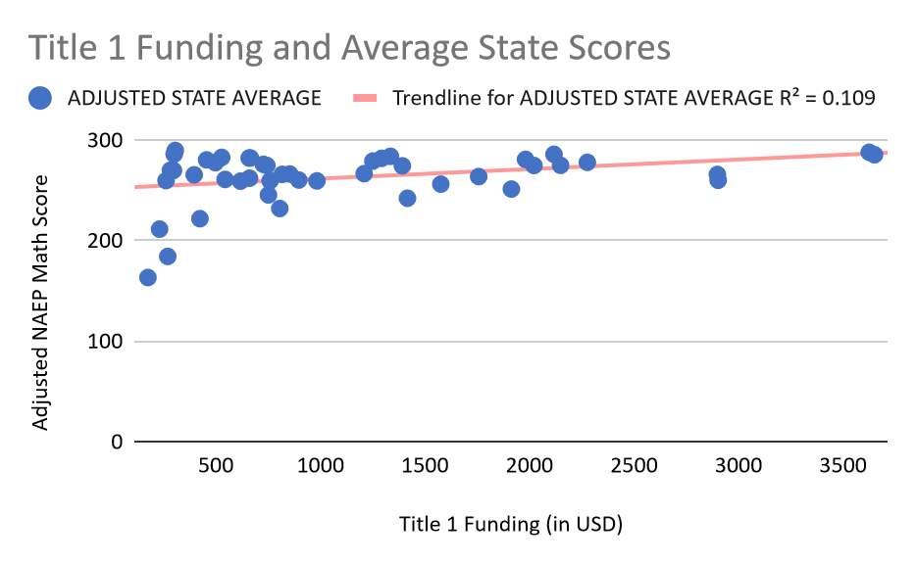
No Child Left Behind = All Children Succeed
No Child Left Behind Act (Title 1) funding and adjusted state average scores were positively correlated and found to have a linear relationship.
This means that as funding goes up, so will test scores. However, this also means that if funding goes down, so will test scores.
This may be because with more Title 1 funding, schools are better prepared to help economically disadvantaged families and to equip their classes with more resources. When students and teachers are better equipped in the classroom, they can be expected to perform well academically.

Slide 8
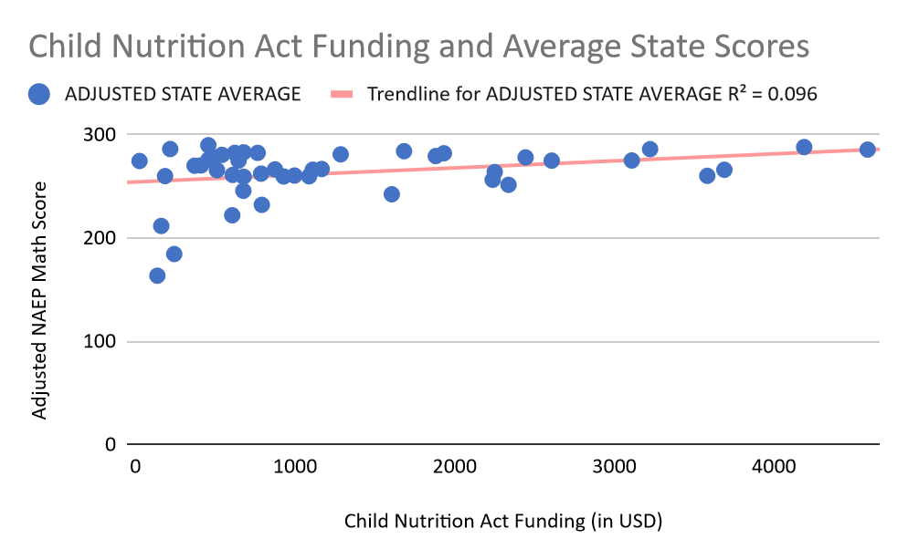
Don’t overlook the importance of nutrition!
Child Nutrition Act funding and adjusted state average scores were positively correlated and found to have a linear relationship.
This means that as funding goes up, so will test scores. However, this also means that if funding goes down, so will test scores.
This may be because with more Child Nutrition Act funding, students are more likely to enjoy healthy meal options for breakfast and lunch at either low cost or for free. When students’ dietary and health needs are attended to, they can be expected to perform well academically.

Slide 9
Financial Strategy
Both types of funding are positively correlated with test scores.
However, the strongest relationship seems to come from Title 1 funding.
Priority of the two sources of revenue
No Child Left Behind funding is important to those schools with more students who are from low-income backgrounds.
This is the higher priority revenue source to secure and efficiently allocate.
Beneath this is Child Nutrition Act funding.
Other sources of revenue
Other sources of revenue should be ranked beneath these two sources, with priority to be established in collaboration with the district superintendent, school principals, and the district financial department.

